Slide 1
Predicting Health Insurance Claim Denials
DSC 630
Rhianna Ruggiero

Slide 2
agenda
INTRODUCTION 3
FINDING & VISUALIZING THE DATA 4
PREPARING THE DATA 6
CREATING & EVALUATING THE MODELS 7
RESULTS & FINDINGS 9
CONCLUSIONS 10

Slide 3
Introduction
Insurance claim denials cause issues for both hospitals/doctors offices and patients that can be costly
Patient’s medications can be delayed which can be dangerous and hospitals and private practices will not get reimbursed in a timely manner
Having a predictive model in place that can look at claims before they are submitted and flag ones that might be denied would help reduce denials and help both patients and practices
A model should help users determine if a claim may be denied or not and show which claims might need to be looked at a second time before submitting and which ones can be submitted.

Slide 4
Finding the Data
The first data set that I used for this project came from Kaggle and contained randomly generated insurance claim information
This data set only contained information on denied claims however which prevented me from creating a model that would be able to predict which ones would get denied and which ones would be accepted/paid
I found a new data set on Kaggle that contained information on both paid and denied claims so that I could create a model to learn what the difference is between paid and denied claims
Link: https://www.kaggle.com/datasets/leandrenash/enhanced-health-insurance-claims-dataset

Slide 5
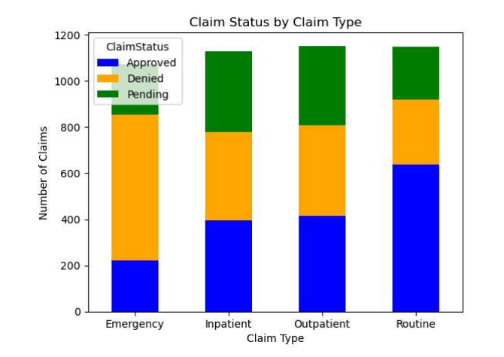
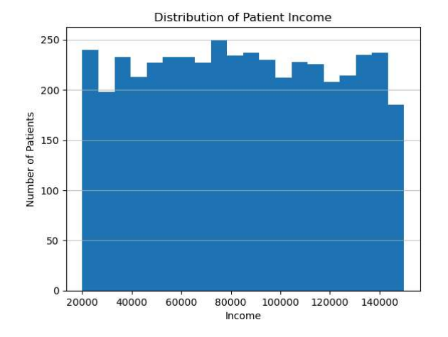
Visualizations

Slide 6
Prepping the Data
Various updates were made to the data including removing any in progress insurance claims and any data with high cardinality including ClaimID, PatientID and ProviderID
After doing some analysis on the data, I also discovered the diagnosis code, procedure code and provider location columns contained mainly unique values and were removed as well
New features were added to the data set including a claim amount to income ratio that would show the relationship between these two columns
The ages of the patients were also binned into different ranges so see if certain age ranges had more claim denials
Claim type and claim submission were combined to see if there was a relationship between the data in these columns as well
I also created dummy variables for the categorical columns

Slide 7
Choosing the Model
Decision Tree Model
This model had an accuracy around 67% with a depth of 5
After adding new features to the data the accuracy decreased to 56.3%
Could have been overfit which led to the decrease in accuracy
Random Forest Model
Uses multiple decision trees and had a lower initial accuracy of 64.7%
After adding new features accuracy decreased to 63.3%
This ensemble model reduces overfitting that occurs in decision tree models
Decided to continue with random forest to try and tune the model to catch as many denied claims as possible

Slide 8
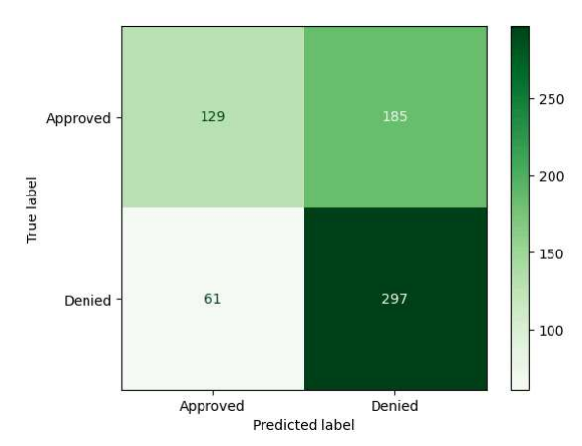
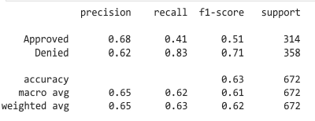
Model Updates & Evaluation
Threshold decrease to 0.4 to increase denied recall
Use Grid Search to find the best parameters for the model
Denied recall increased to 83% with confusion matrix on the right
Accuracy was only 63%, but we care more about denied recall in this situation

Slide 9
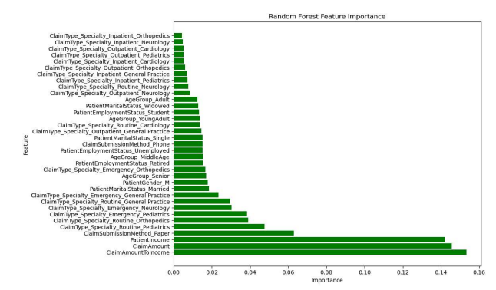
Results & Findings
Claim amount to income ratio was the most important predictor of claim approval/denial
Claim amount and patient income separately were also important
Paper claim submission method was semi-important but not as much as the other predictors

Slide 10
Conclusion & Recommendation
Claim amount and patient income were the most influential features on predicting denials
There is room for improvement and could be accomplished with the addition of more features or with more data
Ethical Considerations
Results must not be used to discriminate against patients based on income
Model should be used as a guideline
HIPAA laws must be adhered to
Model should be updated over time and reviewed by experts

Slide 11
What I learned
Finding and cleaning data
How to determine model “accuracy”
Tuning a model
Feature engineering

Slide 12
References
Frank, E. L. (2018, October 18). Understanding the F1 score. Medium. https://ellielfrank.medium.com/understanding-the-f1-score-55371416fbe1
hpaulj. (2018, April 11). How to set threshold to scikit-learn random forest model [Answer]. Stack Overflow. https://stackoverflow.com/questions/49785904/how-to-setthreshold-to-scikit- learn-random-forest-model
Patino, C. M., & Ferreira, J. C. (2021). Recall bias. In StatPearls [Internet]. StatPearls Publishing. https://www.ncbi.nlm.nih.gov/books/NBK557812/
Ranked, C. (2023, December 4). Common reasons for insurance claims denials. EnableComp. https://enablecomp.com/denial-prevention-and- resolution/reasonsfordenial/#:~:text=Incorrect%20or%20duplicate%20claims%2C%20lack,also%2 0likel y%20to%20be%20denied.
Steinzor, P., & Grossi, G. (2025, February 27). How insurance claim denials harm patients’ health, finances. AJMC. https://www.ajmc.com/view/how-insurance-claim-denialsharm-patients-health-finances

Slide 13
thank you

